Slide 1

SAP Build Training for Corporate Professionals
DAY-30
www.anubhavtrainings.com

Slide 2


DISCLAIMER
The training content and delivery of this presentation is confidential, and cannot be recorded, or copied and distributed to any third party, without the written consent of Anubhav Trainings

Slide 3
Agenda
Create Table in SAP ABAP on Cloud
Upload Data
Create CDS entity
Enable Operations and Service

Slide 4


Mia
Mia is a young entrepreneur owning a multi million-dollar business of manufacturing printers, projectors, & smart phones. Her service team wants to manage customer service orders that basically a digital work ticket that tracks when Mia’s company needs to provide a service to a customer. She want to create a solution using SAP BTP which
Helps service foreman to track the status of service orders and items (material, product hierarchy) which needs to be repaired or replace.
Provide secure Access of data to the users and upload excel data to service order tables.
For this purpose, we need to maintain tables, views, security and service in the SAP BTP ABAP Environment.

Slide 5
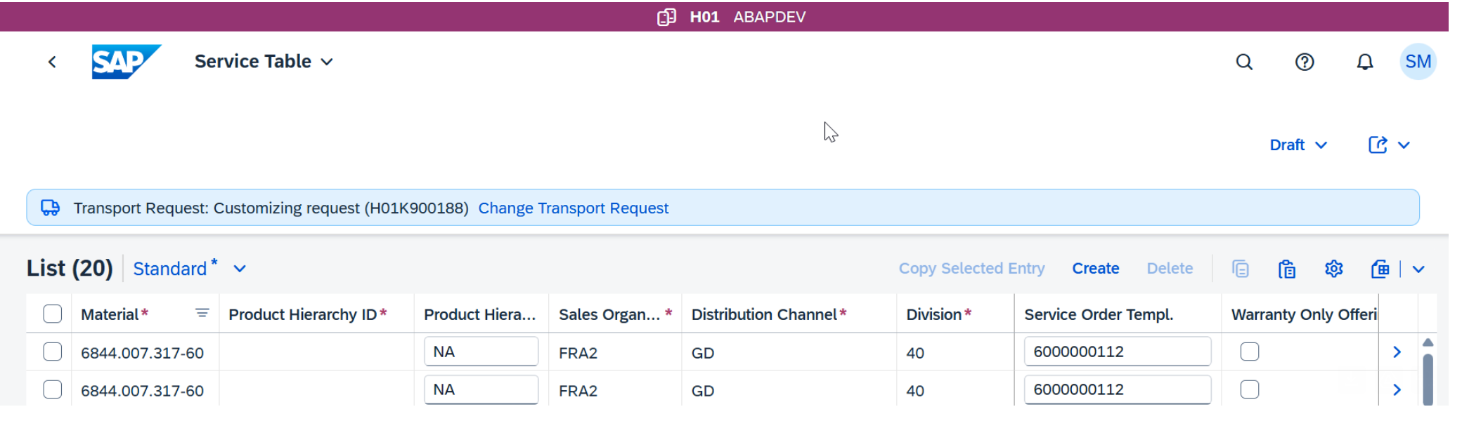
Use Case
How to create custom tables ( Header/items ) on BTP with different data types (e.g., list, value help/F4 options)
Whether data types can be modified later and new fields can be created — and if so, does the whole table need to be regenerated?
How to apply basic authorization on the table to control data visibility/access
Upload data via excel.

Slide 6
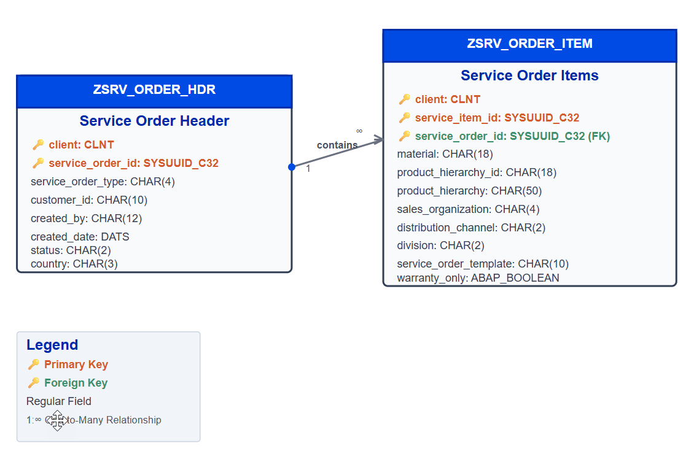
ER Diagram

Slide 7
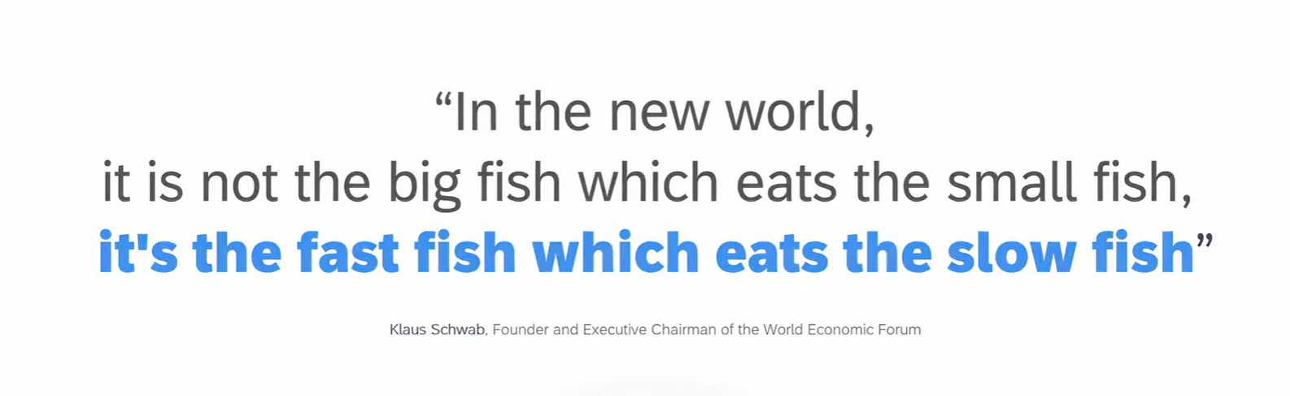
Welcome to the new world

Slide 8



Looming Threats
Geopolitical
Instability
Economic Uncertainties
Disruptive Technologies

Slide 9
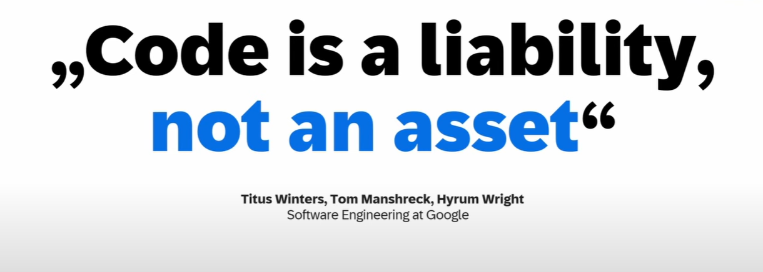
Everything is code

Slide 10
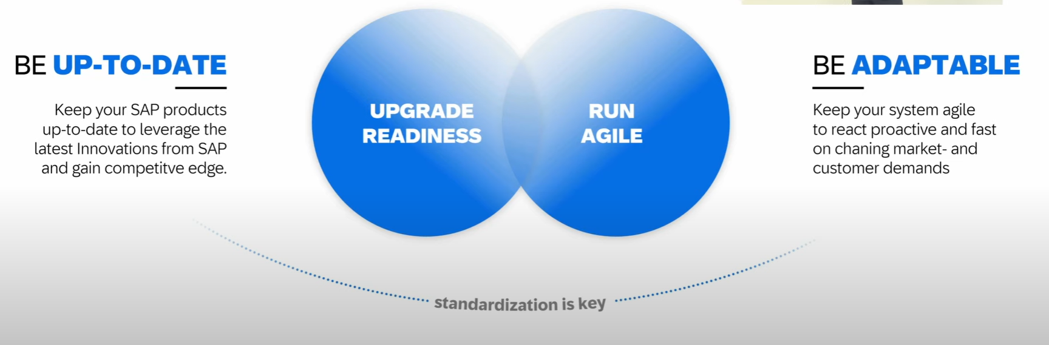
How to be fast

Slide 11
The Clean Core
Clean means up-to-date, documented, unmodified, consistent, efficient and upgrade ready.
S/4HANA Cloud Private Edition => S/4HANA On-premise – GUI Access, Full Control on system, upgrade when customer want, postpone upgrades, SPRO Access, Full access to system code like ECC – 85-90%
S/4HANA Cloud Public Edition => Shared environment, Infra is owned by SAP, not have full control and code, No SAPGUI access, only through browser, Force upgrade (always up to date) -10~15%
Capabilities of clean core depend on Software stack.
Bundle for Rise/Grow with SAP – ERP (Core S/4HANA), BTP (BTPEA), SAC, DS…

Slide 12
Benefits of Clean Core
Access to Innovation – all the latest S/4HANA features can be accessed faster because since you don’t have dependency on custom code, you can upgrade in short time, agile to decide. SAP partners can offer upgrade at fix price.
Upgrade Simplicity – You can apply upgrades stress free.
Lower TCO – Since we follow clean core, we actually use upgrade safe APIs to develop our custom apps. This remains stable release-on-release.
Enhanced security – secure your data and applications which are exposed in cloud.
Improved performance – core is clean, it doesn’t have to interact with lots of custom code, store custom code hence increase the speed.
Data Simplification – which data is privates, which data is public.

Slide 13
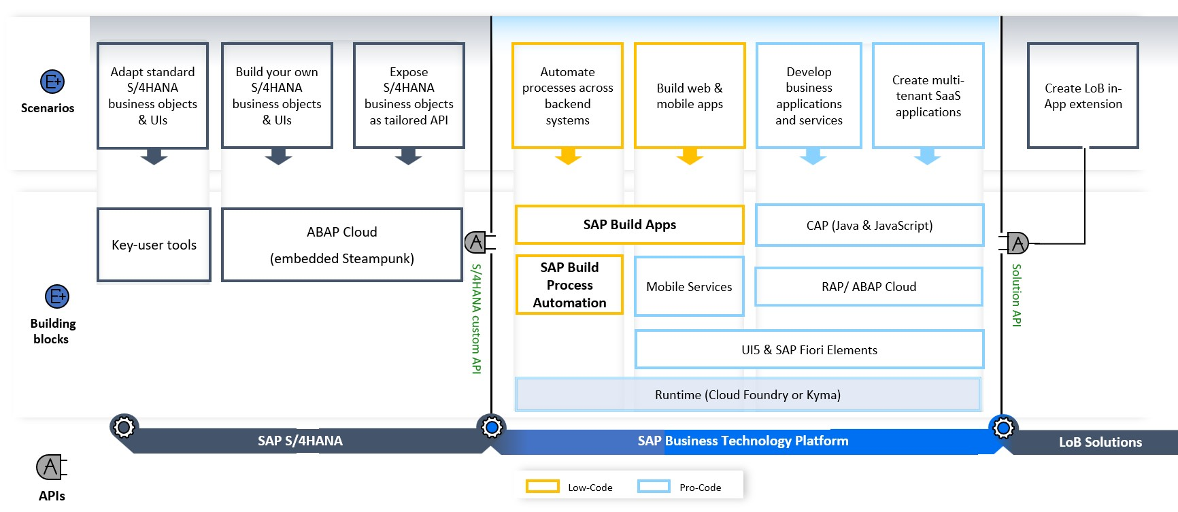
High level guidance

Slide 14
SAP Business Accelerator HUB
The SAP Business Accelerator Hub (formerly known as SAP API Business Hub) is a central, cloud-based platform provided by SAP that offers access to a wide range of APIs, pre-packaged integrations, and business services. Located at https://api.sap.com , it serves as a comprehensive catalog for developers, partners, and enterprises looking to explore, test, and adopt SAP's digital capabilities. The hub provides resources that span various SAP products like S/4HANA, SuccessFactors, Ariba, and more, enabling seamless integration into SAP and non-SAP systems through standardized APIs and events.
Users of the SAP Business Accelerator Hub can interact with APIs in a live sandbox environment, download pre-configured integration packages, and access detailed documentation and code snippets. The platform supports both SAP BTP (Business Technology Platform) and third-party development, accelerating innovation and reducing time to value. It is an essential tool for enterprises undergoing digital transformation, allowing for rapid prototyping, scalable integration, and efficient development across a variety of business domains.

Slide 15

The Use case
Background:
Meet Emi is an SAP consultant working on multiple SAP S/4HANA projects. Her responsibility includes maintaining and updating business partner address data within the SAP S/4HANA system.
As part of her organization's clean core strategy, Emi wants to avoid direct customizations inside the S/4HANA system. Instead, she plans to build a side-by-side extension application using SAP Build Apps on the SAP Business Technology Platform (BTP) to manage business partner updates more efficiently and in a user-friendly manner.
Key considerations:
Mia uses SAP Build Apps, a low-code/no-code tool on BTP, to develop a standalone application that connects to the SAP S/4HANA system via public APIs available on the SAP Business Accelerator Hub.
She is not expert in coding
The application should work in user’s mobile phone
She is trying to beat the time as the requirement is quite urgent
A cloud solution is required to fulfill the requirement

Slide 16
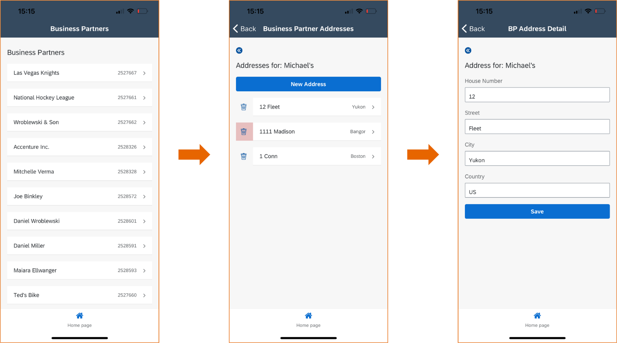
Solution Flow

Slide 17
Functional Spec
You will create an app with 3 pages:
Page 1: Display all business partners
Page 2: Display all addresses for a business partner
Page 3: Create or update an address
As for complexities of the API, here are a few:
You cannot delete an address if it is labeled as the default address (AddressUsage = XXDEFAULT).
Whether an address is the default is determined by the AddressUsage nested entity, which you will need to expand.
If you add an address to a business partner that has no addresses, that address must be labeled as the default address, but if you are adding an additional address, that address CANNOT be labeled as the default address.
There are all types of conditions for the data. For example, if you add an address from the United Kingdom, it must include a postal code (Postal codes are not needed for the US or Sweden). Or, you cannot delete the default address.

Slide 18
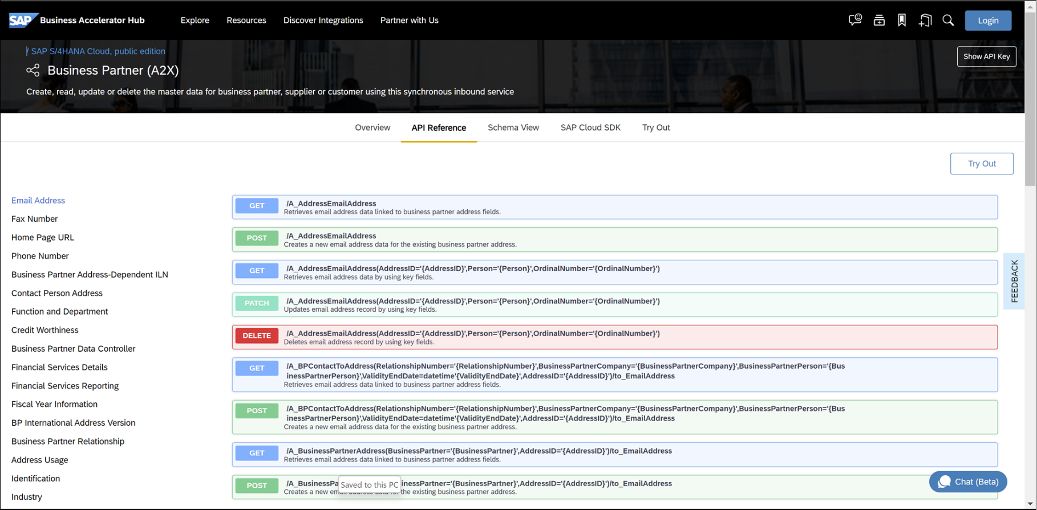
SAP Business Partner API

Slide 20

What We Did
Let’s Summarize
www.anubhavtrainings.com

Slide 21
www.anubhavtrainings.com
Thank You
End of Day 28
www.anubhavtrainings.com

Slide 22



We’re committed to empower you to be
#FutureReady
through powerful training solutions.
We build the workforce of the future.
250+
Corporate Clients
30,000+
Learners Trained
25000+
Learners Placed
FREE WEBINARS
Sign up for free webinars with industry experts every fortnight!
Enroll Now!
Contact us today!
https://anubhavtrainings.com

